Slide 1
Advanced Industrial Design Engineering
GRAP2575
Lecturers: Nick Johns & Rick Butcher

Slide 2
Engineering for manufacture
Lean manufacturing
Design for disassembly and re-manufacture
Scalable, distributed and open-source modes of advanced and additive manufacturing
Mass-manufacture
Mass-customization
The social, cultural and environmental dimensions of product manufacturing and use will also be explored.

Slide 3
Show and Tell
If you find any interesting videos, websites or articles relating to manufacturing, materials or processes please share them.
Email a link to your lecturer
Will be uploaded onto myRMIT

Slide 4
Week #1 – Engineering Autopsy
Product Engineering Autopsy
Case studies (digital and 3D products) of products, materials, manufacturing processes.
In-class discussion related to the case studies presented.
Highlights of what will be explored during the semester.
Task beyond class
Read chapters 1-3 of prescribed textbook.
Source a product for assignment one to bring into class week two.
Students to identify a product that they believe is a good example in the use of materials and/or manufacturing process.
To be uploaded onto myRMIT before the next class and/or to bring into class week two.

Slide 5
Week #2 – Engineering Autopsy
Product Engineering Autopsy
Disassemble and reassemble your chosen products and document the process.
Task beyond class
Document the disassembly of your chosen assignment one product in stop motion format.
Take a high quality image of the components laid out neatly. The work undertaken will be for partial assessment of assignment one.
Bring disassembled product and tools to class in week three
Read chapters 4-6.
To be uploaded onto myRMIT before the next class and/or to bring into class week three.

Slide 6
Lost Trades

Slide 7
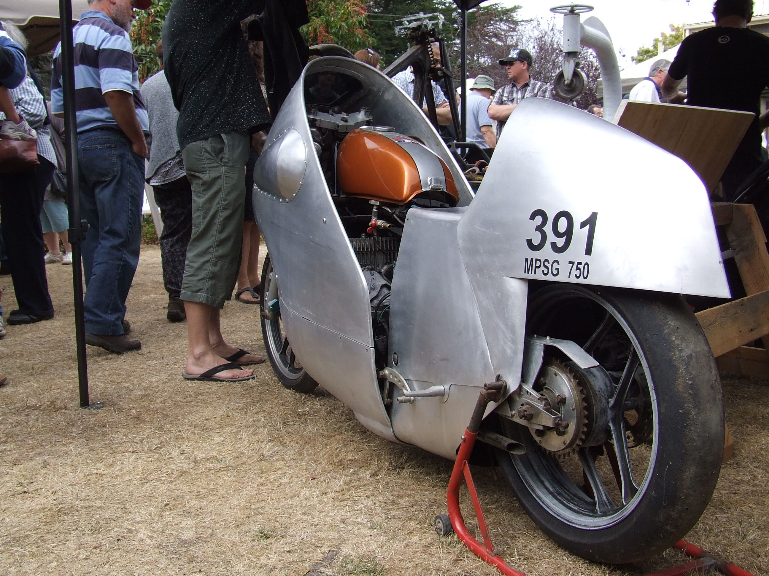

Slide 8
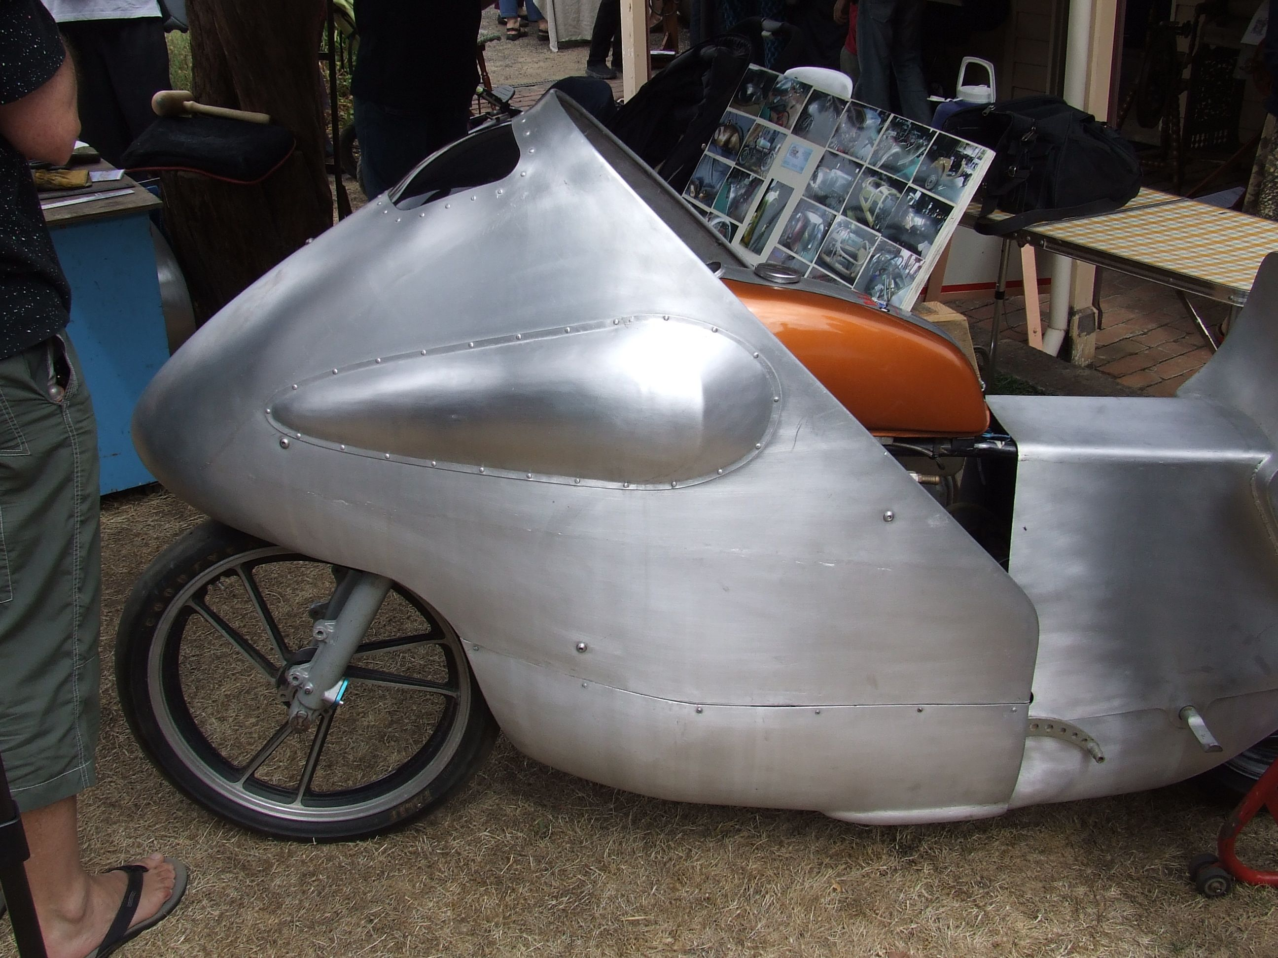

Slide 9
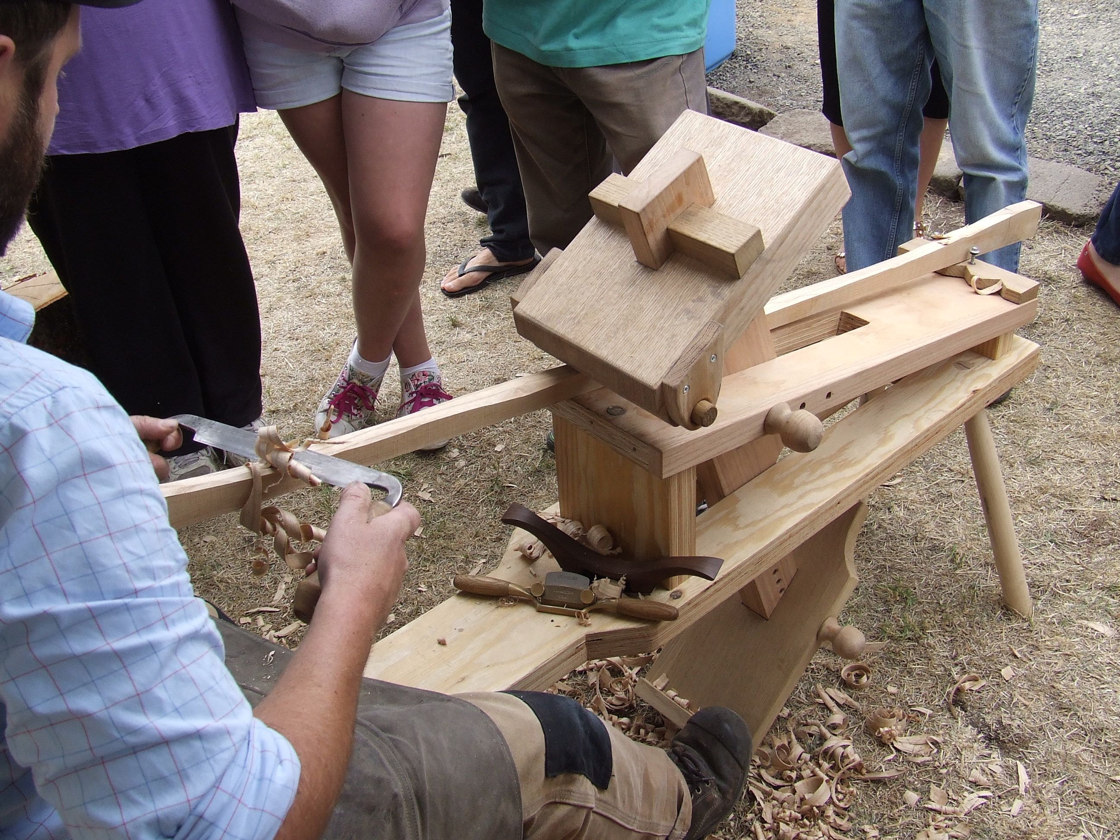

Slide 10
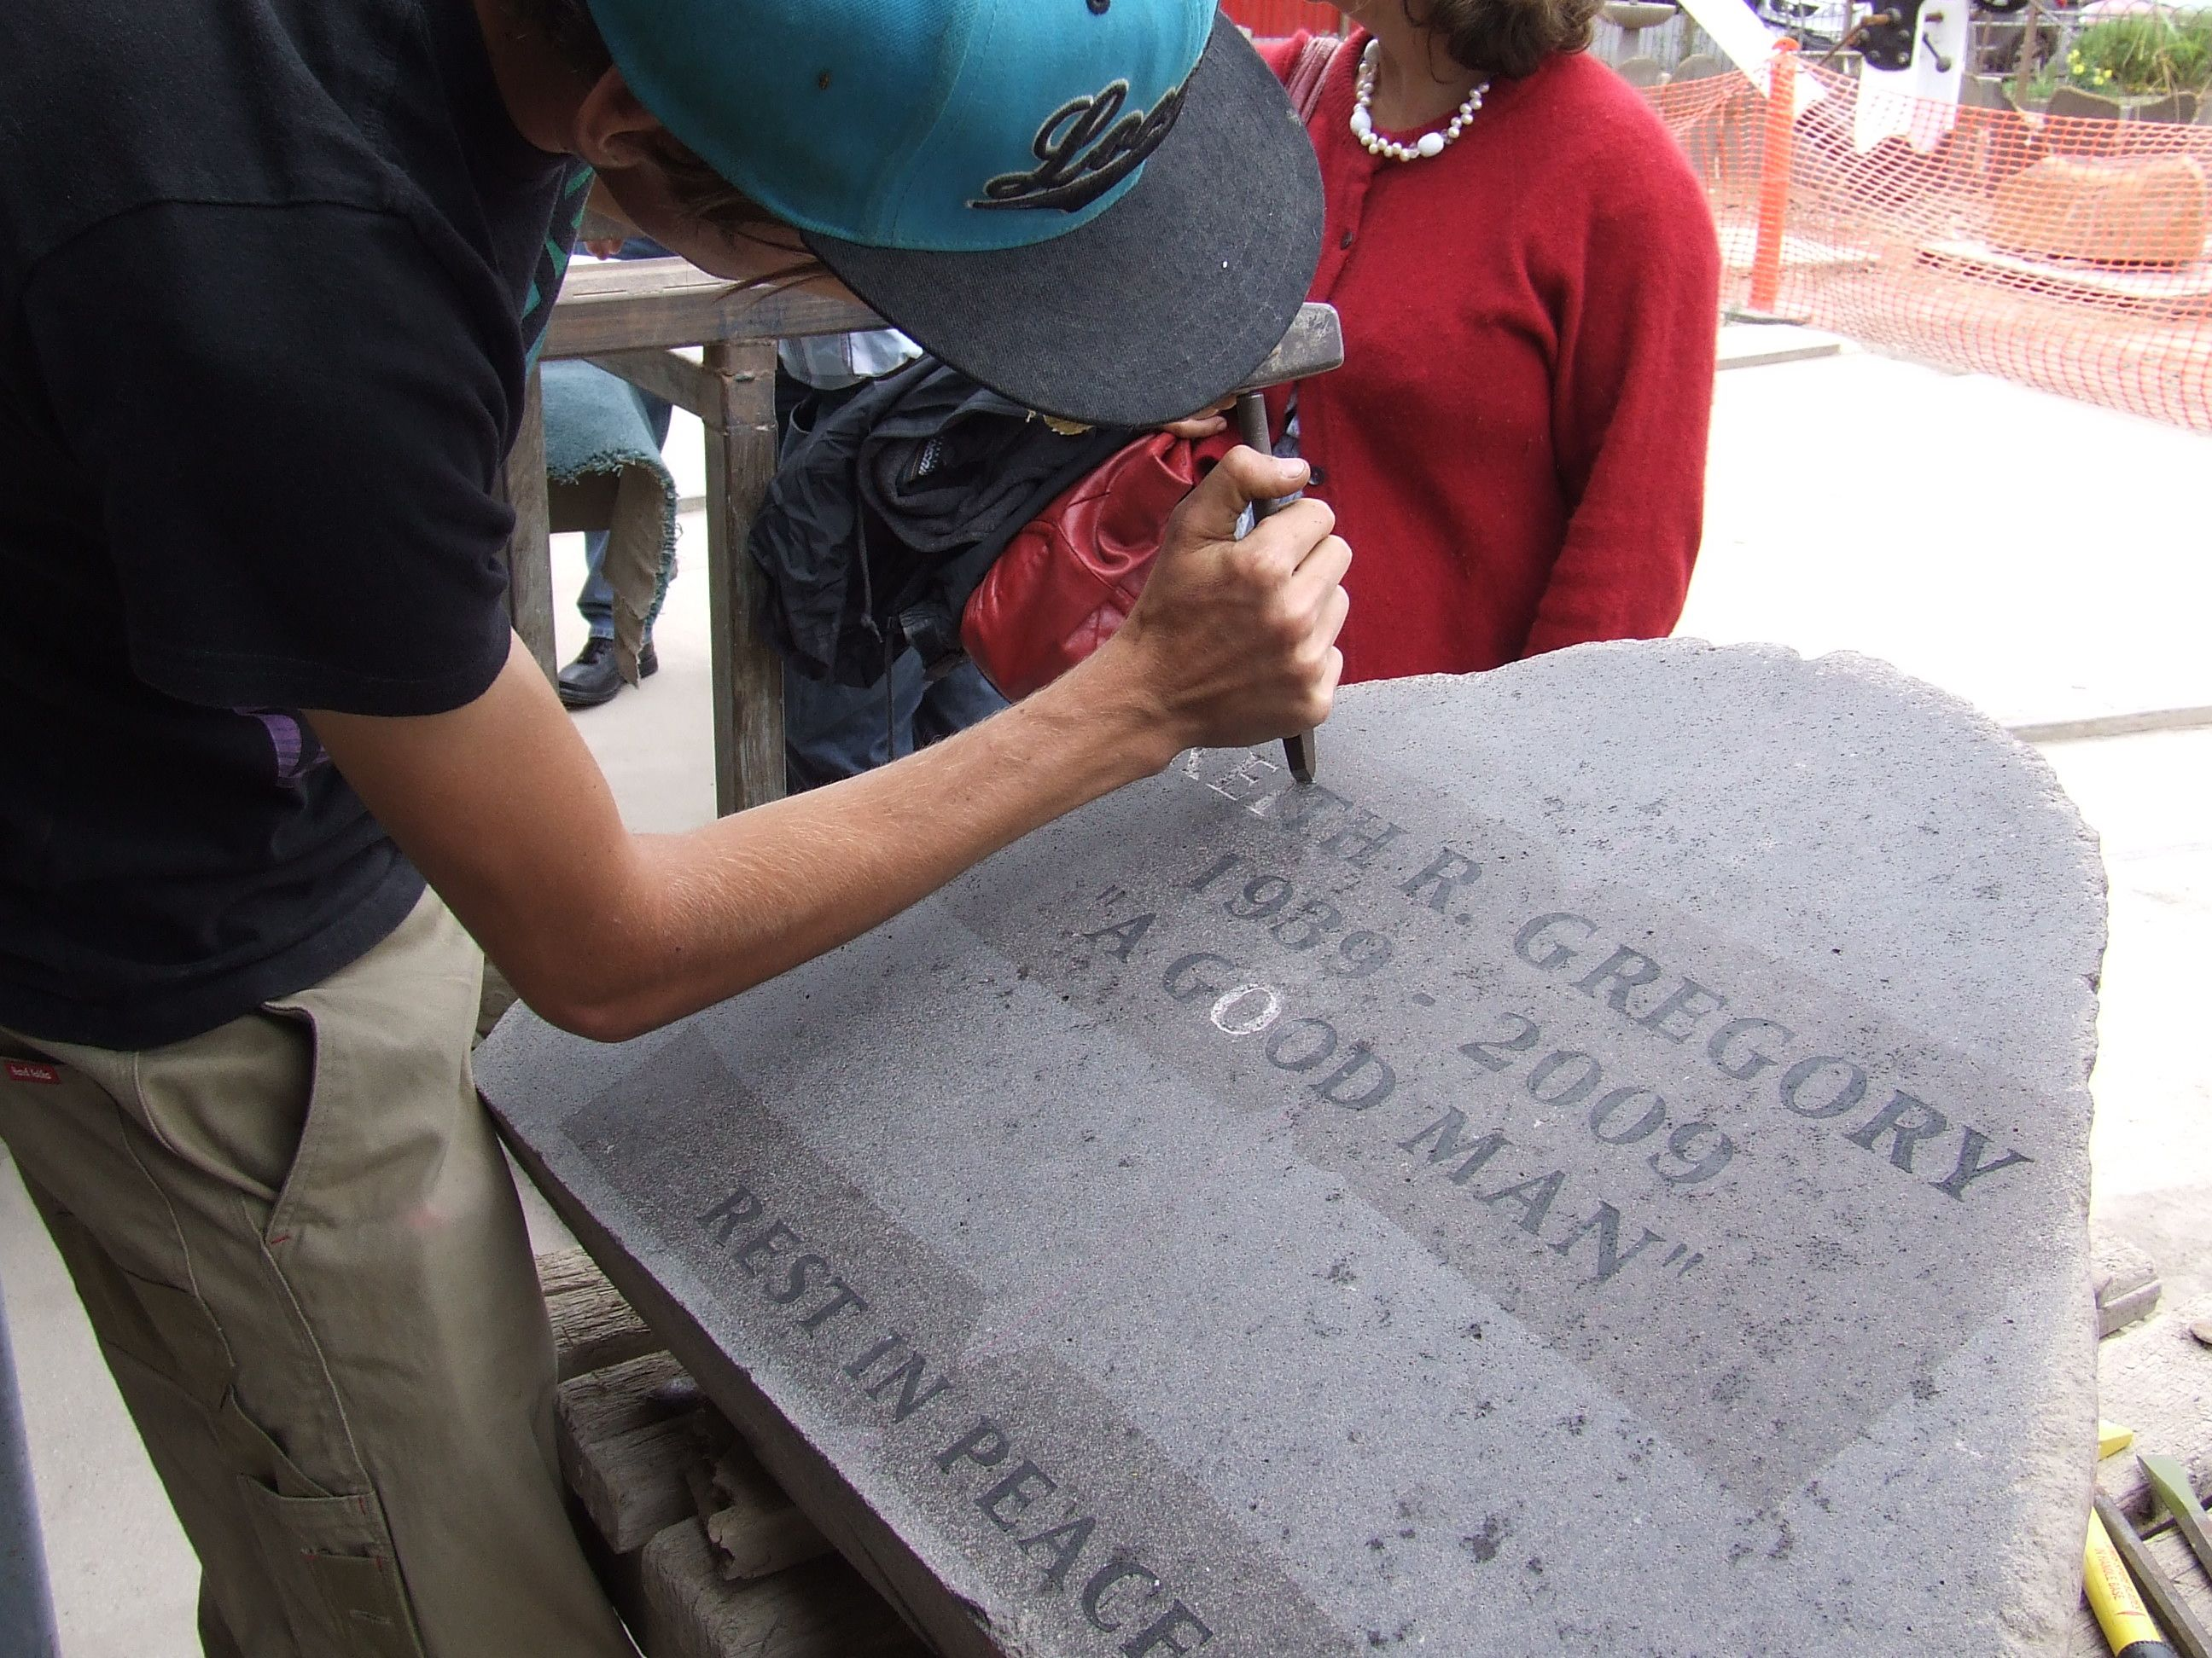

Slide 11
Week #3 – Engineering Autopsy
Product Engineering Autopsy
Identify & catalogue material types, processes and surface treatments of each component.
Weigh and dimension.
Analyse and document how the components are fastened together and how they are positioned within the product.
Task beyond class
Transfer the material and manufacturing information undertaken in class into your product autopsy report.
Add this data to the high quality image of the components laid out.
Read chapters 7-10.
To be uploaded onto myRMIT before the next class and/or to bring into class week four.

Slide 12
Indexing products by attributes

Slide 13
Defining your product intention
As designers we want to build products which have their own voice, their own story – built upon foundations of the product’s brand.

Slide 14
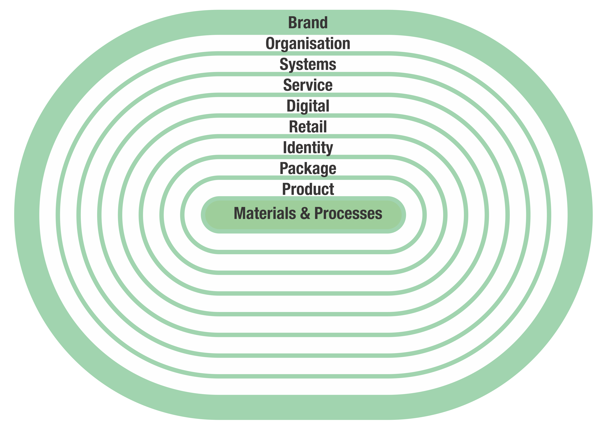

Slide 15
Intentions in design
A single product may have more than one dominant intention, such as;
Market
For public / private use…
For women / elderly…
Economics
Minimum cost
Assembly
Sustainable
Recycling / biodegradability
Performance
Maximum Insulation

Slide 16
Appeal & characterization
Write a short story (around 200 words) to place your autopsy product in context.
Base the story on the components of the brand – as shown at right.
Brand
Organization
Systems
Service
Digital
Retail
Identity
Package
Product
Materials & Processes

Slide 17
Family, Class, Member & Profile

Slide 18
Shaping, Joining & Surface

Slide 19
Shaping, Joining & Surface

Slide 20
Shaping, Joining & Surface

Slide 21
Aesthetic attributes
Touch
Warm, cold, soft, hard, flexible, stiff
Sight
Optically clear, transparent, translucent, opaque
Reflective, glossy, matte, textured
Hearing
Muffled, dull, sharp, resonant, ringing
Low pitched, high pitched
Taste / Smell
Bitter, sweet
Acidic, alcoholic
Non-toxic, toxic
Child safe, unsafe

Slide 22
Perceptions of attributes
Aggressive / passive
Cheap / expensive
Classic / trendy
Clinical / friendly
Clever / silly
Common / exclusive
Decorated / plain
Delicate / rugged
Disposable / lasting
Dull / sexy
Elegant / Clumsy
Extravagant / restrained
Feminine / masculine
Formal / informal
Hand / mass produced
Honest / deceptive
Humorous / serious
Irritating / lovable
Mature / youthful
Nostalgic / futuristic

Slide 23
Simple & deep indexing
Simple indexing deals with facts
Eg. I’m looking for a material with an opacity which is ‘Optically clear’
Deep indexing is more about
Synthesis: eg. I’m looking for a material which feels spongy…
Similarity: eg. I’d like to use a similar material to another product…
Inspiration: eg. By being immersed in a random field

Slide 24
Map your components
Classify each component material as
Family
Class
Member
Profile
Classify each component process as
Family
Class
Member
Profile
Plus Aesthetic attributes & Perceptions of attributes

Slide 25
Failure mode and effects analysis
Failure Mode and Effects Analysis (FMEA) was developed by reliability engineers in the 1950s to study problems that might arise from malfunctions of military systems.
An FMEA is often the first step of a system reliability study.
It involves reviewing as many components, assemblies, and subsystems as possible to identify failure modes, and their causes and effects.
An FMEA is mainly a qualitative analysis.
An FMECA is a critical analysis.

Slide 26
Different types of FMEA analysis
Functional FMEA
Design FMEA
Process FMEA
Critical analysis (FMECA)
Inductive reasoning (forward logic) single point of failure analysis and is a core task in
reliability engineering
safety engineering and
quality engineering.
Quality engineering is specially concerned with the ‘Process’ type of FMEA. (Manufacturing and Assembly)

Slide 27
FMECA benefits
It provides a documented method for selecting a design with a high probability of successful operation and safety.
A documented uniform method of assessing potential failure mechanisms, failure modes and their impact on system operation, resulting in a list of failure modes ranked according to the seriousness of their system impact and likelihood of occurrence.
Early identification of single failure points (SFPS) and system interface problems, which may be critical to mission success and/or safety. They also provide a method of verifying that switching between redundant elements is not jeopardized by postulated single failures.
An effective method for evaluating the effect of proposed changes to the design and/or operational procedures on mission success and safety.
A basis for in-flight troubleshooting procedures and for locating performance monitoring and fault-detection devices.
Criteria for early planning of tests.

Slide 28
Life Cycle Eco-systems

Slide 29
Life Cycle Eco-systems
What eco-system does this fit?

Slide 30
Paper vs. Foam Coffee Cups
vs.
The lid for cups have not been assessed as they are the same for both cups.

Slide 31
Production Impacts by Weight
Per kg of material the paper has 1/4 of impact compared with EPS. But the paper cup weighs18g whereas the EPS cup weighs only 4g.

Slide 32
Production Impacts per Cup
Per manufacture of each cup the paper cup has greater impact due to weight per unit - Density. This is assuming that both cups end up in landfill = single use and materials disposed of.

Slide 33
Benefits of Recycling Paper Cup
If the paper cup is recycled but not the EPS one then the paper one starts performing better.

Slide 34
Benefits of Using Recycled Paper
If you do not use virgin paper but instead recycled pulp then finally the paper cup starts to perform much better.

Slide 35
Annual Consumption of Coffee Cups
The benefits of using a re-usable (not disposable) cup even when you factor in the washing of the cup after every use.

Slide 36
Life Cycle of Aluminium Cans
Aluminium Cans
http://www.youtube.com/watch?v=LXQc08D1lPk#t=654
Rexam cans
http://www.youtube.com/watch?v=7dK1VVtja5c

Slide 37
Cradle to cradle design
The collection of ingredient data throughout the supply chain until the product is mapped out down to the parts per million level.
Once an inventory is complete, a product’s impacts to humans and the environment is evaluated in five categories:
Material Health, Material Reutilization, Renewable Energy & Carbon, Water Stewardship, Social Fairness.
Ref. McDonough Braungart Design Chemistry (MBDC) is a firm founded in 1995 by world-renowned architect William McDonough and chemist Dr. Michael Braungart.

Slide 38
Adoption of new materials
Industries inclined to try new materials typically
Are not risk averse (safety is not put at risk)
Value performance (Defence & games / gaming)
Are material cost insensitive (eg. High end goods)
Communication of ideas & true capabilities is the biggest challenge
Clear & complete materials profiles are needed
Materials workshops bring scientists & designers together

Slide 39
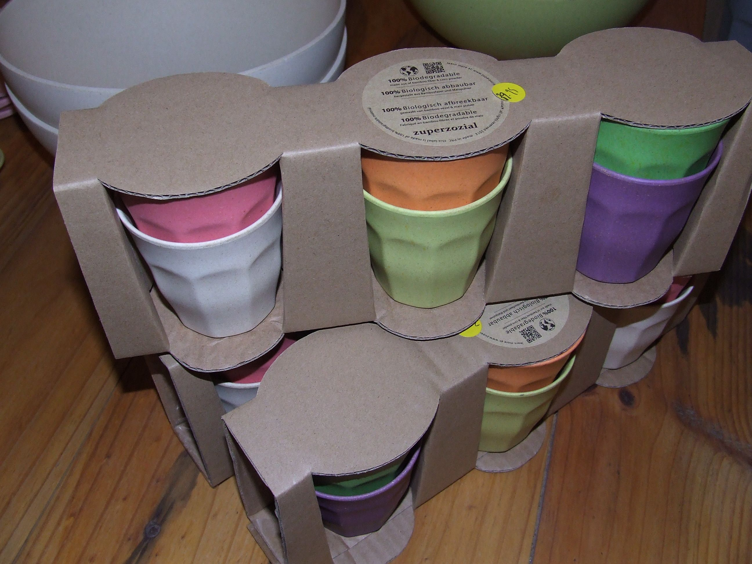

Slide 40
Development of new materials
IDEO developed this bicycle saddle for Brooks around a new material
Using a natural latex rubber & cotton composite for the seat interface
On a diecast aluminium substructure
http://www.ideo.com/work/a-new-generation-of-bike-saddles/

Slide 41
Telling the right story
Express the materiality of each object.
Build tangible connections between the brand that is represented, the object that is created & the experience that is enabled.
Be relevant & meaningful to consumers
Make real by the materials & processes specified.

Slide 42
Balance structure & chaos

Slide 43
Homework
Read chapters 7 - 10 of ‘Materials and Design’
Stop motion video should be finished by next week to allow time for weighing & assess components in class next week.
Post a link to Blackboard so we can see progress
Start writing draft review of autopsy product.
To be uploaded onto myRMIT Blackboard before the next class and/or Vimeo.

Slide 44
Homework
Blackboard interaction is necessary to remain in touch
Log in at least once a week
Check messages
Upload content of interest to group
Start collaborating

